Slide 1

Credit Risk
DSE I2100 - Applied Machine Learning
Laura Estaire, Artjola Meli, Shradha Godse, Wayne Lam
Project Final Presentation
CCNY DSE I2100 - Applied ML and Engineering - Credit Risk Project

Slide 2
Outline
Project Statement
The Dataset
Summary
Tables Granularity
Data Model Schema
Data Preprocessing
EDA
Baseline Model
Models
Metrics
Improvements to Model
Final Model
Conclusion
CCNY DSE I2100 - Applied ML and Engineering - Credit Risk Project

Slide 3


Problem Statement
Credit Risk Model Stability
Competition:
Kaggle and Home Credit
Credit risk:
The possibility of a loss resulting from a borrower's failure to repay a loan or meet contractual obligations
Goal:
Accurately determine which clients can repay a loan using financial history, current financial status, and socio-economic factors
Stakeholders:
Lenders, Borrowers, Regulators, Investors
CCNY DSE I2100 - Applied ML and Engineering - Credit Risk Project
Notes:
First, our problem. We chose a kaggle competition hosted by Home Credit, an international consumer finance provider.
So what is credit risk? Credit risk is the possibility of a loss resulting from a borrower's failure to repay a loan or meet contractual obligations
Traditionally, it means the borrower does not make the promised loan payments, leading to a loss for the lender.
The goal of the competition and our project is to accurately determine which clients can repay a loan.
This is accomplished by utilizing data on the financial history, current financial status, and other socioeconomic factors of a particular client or applicant.
Stakeholders in this include:
Lenders: Financial institutions like banks, credit unions, and consumer finance companies
Borrowers: Individuals or entities seeking loans for various purposes
Regulators: Government and regulatory bodies that oversee the lending industry
Investors: Entities or individuals investing in financial products that involve credit risk

Slide 4
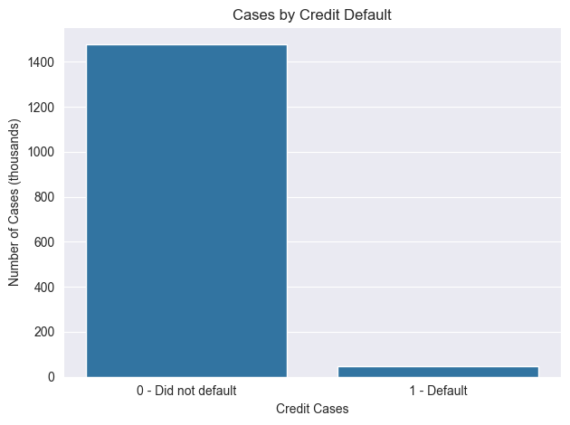
The Dataset
Summary
Binary Target:
Default: positive class, 1
No default: negative class, 0
Cases: >1.5M
Negative class: ~1.45M
Positive class: ~50K
Imbalance:
Ratio:
Missing values: 92%
Features: >400
Mix of data types
Examples: industry of employment, number of clients who have used the same mobile number
Sources: 8
Number of tables: 17
Data depth: Static and transactional
CCNY DSE I2100 - Applied ML and Engineering - Credit Risk Project
Notes:
The credit risk in the dataset we worked with is defined in a binary target.
The positive class, flagged as 1, indicates that a particular case has defaulted on their loan.
The negative class, where a case has not defaulted on their loan, is denoted as 0 in the dataset.
There are over 1.5 million individual cases in the dataset, with roughly 1 million 450 thousand of the negative class and 50 thousand of the positive class; which is an imbalance of 97 to 3.
The dataset is also comprised of 92% missing values across over 400 features of a mix of data types, including:
Categorical (such as industry of employment), numerical (such as number of clients who have used the same mobile number as the applicant), and dates (such as date of birth)
These features came from 8 separate sources stored in 17 different tables of various depth
And includes static data and transactional data

Slide 5
The Dataset
Granularity: Depth 0, Depth 1, and Depth 2
D0
Indices:
case_id - specific loan case
num_group1 - applicant or associate
0 means applicant
All else means non-applicant
num_group2 - additional entries
Depth 0:
Data directly tied to a single case
Depth 1:
Each case tied to historical record
Includes associated parties
Additional num_group1 index
Depth 2:
Each case tied to historical record
Includes associated parties
Additional num_group1 and num_group2 indices
Case ID | App. Count | Credit Type
1 | 5 | “CAL”
2 | 3 | “REL”
D1
Case ID | N.G. 1 | Cred. St. | Cred. End
1 | 0 | 2020-8-1 | 2021-9-6
1 | 1 | 2016-1-5 | 2018-8-7
D2
Case ID | N.G. 1 | N.G. 2 | Ph. Ty. | Status
1 | 0 | 0 | “mobile” | “open”
1 | 0 | 1 | “home” | “open”
CCNY DSE I2100 - Applied ML and Engineering - Credit Risk Project
Notes:
To go into more granular detail, we need to talk about the depth in the tables.
First, there are 3 indices
case_id which specifies a specific loan case
num_group1 which indicates if it is an applicant or associate or a historical record
num_group2 which indicates additional entries from an applicant or associate
In the depth 0 tables, each row is indexed by a single case_id
So on the right we can see each row has a unique case_id
In depth 1, each case is tied to a historical record and may include associated parties
Each row’s composite key is the case_id and num_group1
While depth 2 tables, go further with each row’s key being case ID, num_group1, and num_group2.

Slide 6
The Dataset
Data Model Schema: Case ID ties everything
Base
Case ID, Target
Credit Bureau
Depth 1
2 sources
Depth 1
Other
Depth 1
Tax Reg.
Depth 1
3 Sources
Depth 2
2 sources
Depth 2
Person
Prev. Apps
Static
Depth 0
Debit Card
Depth 1
Deposit
Depth 1
Depth 1
Depth 2
CCNY DSE I2100 - Applied ML and Engineering - Credit Risk Project
Notes:
So this is how everything is tied together, with the case_id
…
So in order to work with the data we need to do a large amount of aggregations by case_id

Slide 7
Data Pre-Processing
Aggregate the dataset to the case ID level
Aggregations
By case_id and num_group_1
num_group1 = 0 by itself
num_group1 != 0 together
Numerical
Mean, min, max, sum, median
Dates
Min, max, distinct
Categorical
Mode
Encoded with frequency and binary encoding
Case ID | N.G. 1 | N.G. 2 | Num_1
1 | 0 | 0 | 5
1 | 0 | 1 | 10
1 | 1 | 0 | 4
Case ID | N.G. 1 | Num_1_min | Num_1_max
1 | 0 | 5 | 10
1 | 1 | 4 | 4
CCNY DSE I2100 - Applied ML and Engineering - Credit Risk Project
Notes:
We split the aggregations into 2 separate groups
First where num_group1 = 0, so data that was directly tied to the applicant
And then where num_group1 != 0, so the data not directly tied to the primary applicant
For the numerical aggregations we created 5 columns capturing the mean, min, max, sum, and median of the group
For the date aggregations we retrieve the min, max, and number of distinct dates
And for categorical we retrieve the mode and encode them with frequency and binary encoding

Slide 8
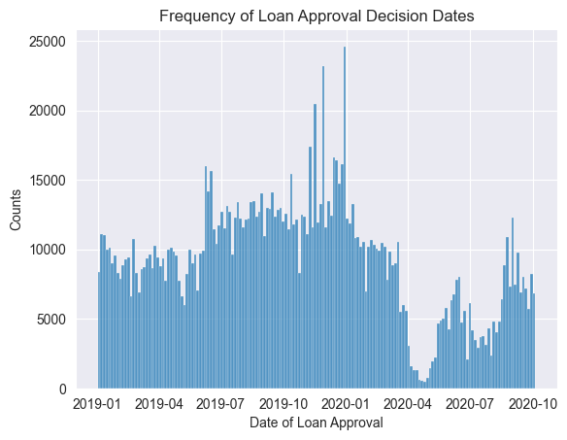
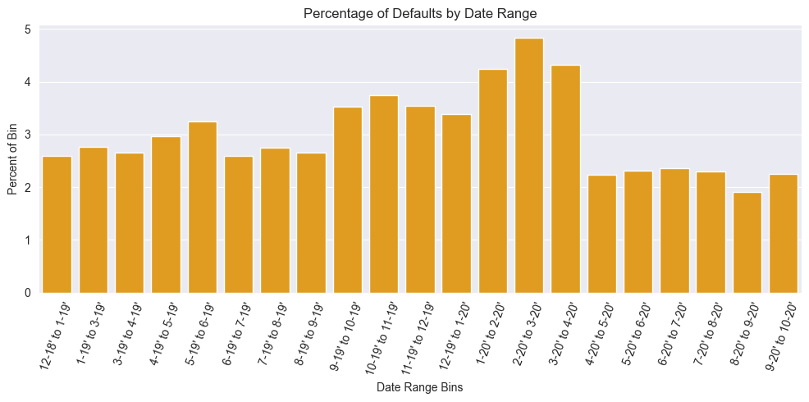
EDA
Date of cases
There is a significant decline in April 2020, COVID-19
Defaults by date
Slight increase in percentage of case defaults in the late-2019 to early-2020
CCNY DSE I2100 - Applied ML and Engineering - Credit Risk Project

Slide 9
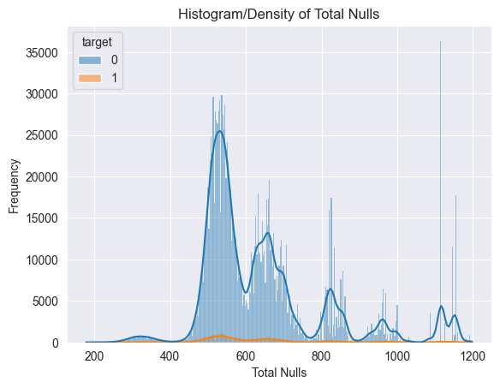
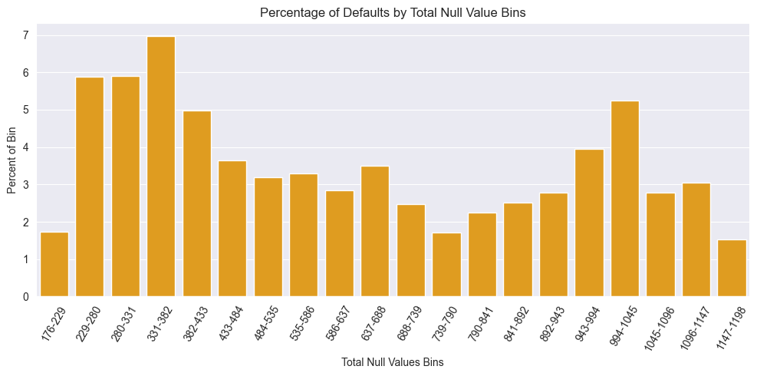
EDA
Total nulls by case_id
Appears to be several clusters
Defaults by total null values
Slight pattern on likelihood of defaults based on total null values
CCNY DSE I2100 - Applied ML and Engineering - Credit Risk Project

Slide 10
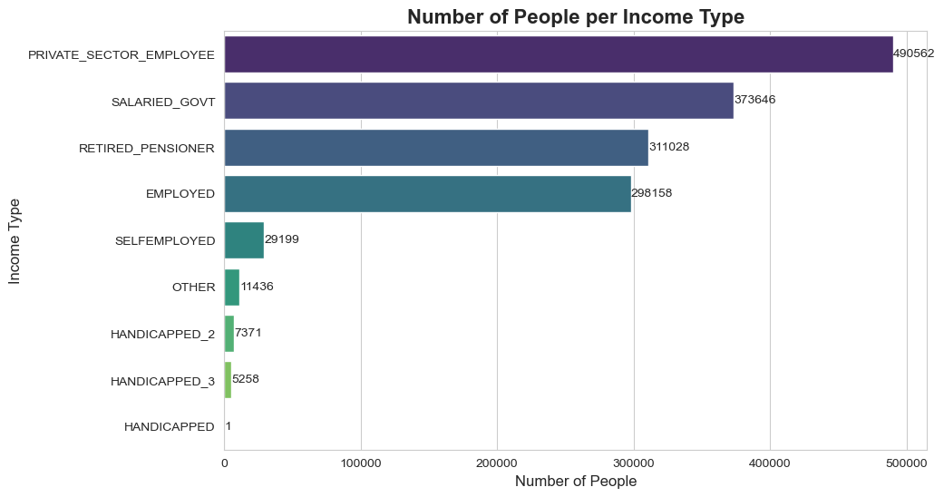
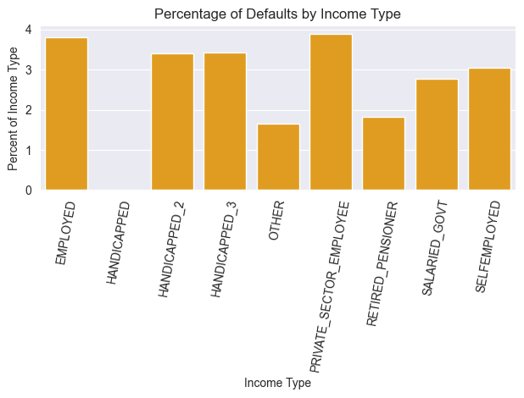
EDA
Income types
Differences in default rates in income types
Private sector employees have highest number and higher default rate amongst all.
CCNY DSE I2100 - Applied ML and Engineering - Credit Risk Project

Slide 11
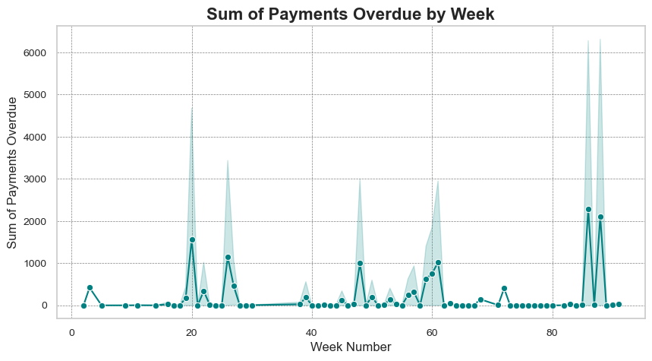
EDA
General Observations
Sporadic Peaks
Significant spikes in overdue payments at weeks 20, 50, and 80
General Low Level of Overdue Payments
Significant Increase Towards the End
CCNY DSE I2100 - Applied ML and Engineering - Credit Risk Project

Slide 12
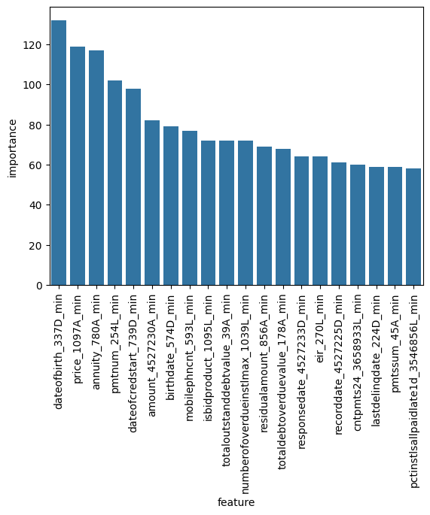
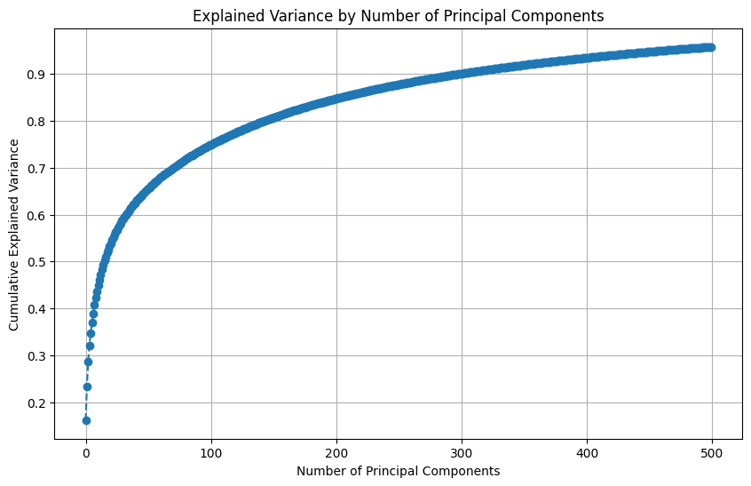
EDA
High complexity: PCA: >400
components required to explain 95% variance
“Elbow” point around 50-100 components → principal components capture most of variance before diminishing returns
Feature importance from LightGBM
Aggregated data held a great deal of importance
Mins dominated top 20 most important features
CCNY DSE I2100 - Applied ML and Engineering - Credit Risk Project

Slide 13
Main Barriers in the project
Domain Knowledge
Selection of relevant features
Imputing missing values with meaningful substitutes
Missing Values
92% missing values
Class Imbalance
Highly imbalanced target data
97% negative class (clients who repaid the loan)
3% positive class (clients who defaulted on their loan)
Class overlap
No major patterns during the initial EDA that make both classes distinct or separable
CCNY DSE I2100 - Applied ML and Engineering - Credit Risk Project

Slide 14


Baseline Models
Establish Baseline Performance Metrics for future comparisons
Random Weighted Model
predict the target label based solely on the average percentage (3% positive) distribution of classes in the entire dataset
Project Baseline
pre-processed data and missing values mean imputation
The best of Logistic Regression, Random Forest or LightGBM on default parameters
CCNY DSE I2100 - Applied ML and Engineering - Credit Risk Project
Notes:
LAU
After doing the EDA and the Data pre-processing explained before, we establish our baseline. The intention was to establish baseline performance metrics, allowing us to compare these initial models with future models that incorporate more advanced transformations and methods.This comparison will help us determine if further transformations lead to statistically significant improvements in accuracy.
We builded two baseline models,
First, We began with a simple random weighted model. Given that only 3% of our dataset belongs to the positive class, this model uses a straightforward approach: it takes an input and randomly assigns a label of 0 or 1. The probabilities are set such that 97% of the time, it assigns the negative class, and 3% of the time, the positive class. This model helps us understand the expected performance based solely on the class distribution of our dataset.
Second, we developed a more sophisticated baseline using the LightGBM model. This model was implemented with default automated parameters, which are generally pre-tuned to perform reasonably well across a broad range of datasets. The only additional preprocessing step involved was imputing missing values using a simple mean imputation technique. This approach is model-centric; essentially, we input the data into the model to see what results it yields without extensive manual tuning.

Slide 15
Baseline Models - Metrics
Establish Baseline Performance Metrics for future comparisons
Metrics | Metrics Meaning | Random Weighted |  | Project Baseline
AUC | Model's ability to distinguish between classes | 0.50 | No better than random guessing | 0.78 | 56% improvement in AUC. Influenced class imbalance
Accuracy | Proportion of all correct predictions (both true positives and true negatives) | 0.84 | Influenced by the class distribution in the dataset. Predicting majority class. | 0.86 | High accuracy, though influenced by class imbalance.
Precision | Proportion of true positives among all positive predictions | 0.15 | Low. Does not have any mechanism to prioritize true positives over false positives | 0.53 | Better predicting positives cases with the trade-off of increase in FP.
Recall | Proportion of actual positives that are correctly identified by the model | 0.04 | Almost unable to identify true positives | 0.13 | Still major challenges in capturing all true positives. Proportional to the class distribution.
F1 | Harmonic mean of precision and recall | 0.06 | Low trade-off between precision and recall | 0.21 | Better trade-off, still not useful
Initial Goal: Build a robust machine learning model capable of effectively predicting true positives in a highly imbalanced dataset with significant missing values.
—> Final Goal: Improve the Project Baseline Model performance.
CCNY DSE I2100 - Applied ML and Engineering - Credit Risk Project
Notes:
LAU
Here we see the metrics that we used during the project to evaluate the model performance, we evaluate the models using AUC, accuracy, precision, recall and F1. Two notes here:
the last three metrics are associated to the positive class. for example, the precision is the proportion of true positives among all positive predictions and so on.
moreover, the results come from a random sample of the dataset of 50 thousand rows where the minority was upsample 4.5 times to 13%.
Let’s look at the random weighted model results,
The AUC score reflects the model's ability to distinguish between classes. We get a score of 0.5 which indicates that the model performs no better than random guessing. Given that this is a random model based on the target's percentage, an AUC score near 0.5 is expected and confirms the model's lack of discriminatory power.
Accuracy measures the proportion of all correct predictions (both true positives and true negatives) out of the total predictions. For this random model, the accuracy is influenced by the class distribution in the dataset. We see that the accuracy score is close to the proportion of the majority class which indicates that the model is leaning towards predicting the majority class more often.
The precision measures the proportion of true positives among all positive predictions. For a random model, precision is typically low as it doesn't have any mechanism to prioritize true positives over false positives.
The recall measures the proportion of actual positives that are correctly identified by the model. We see that this random model's recall is almost 4% not able to identify TP.
Finally the F1 score is the harmonic mean of precision and recall, providing a balance between the two. We see for this model that is very low, reflecting there is no specific pattern in the predictions.
Understanding this random guessing metrics is very important to see from where we start and what to expect due to the data distribution we have.
Finally, we use this LightGBM as the project baseline model, which presents results that are only marginally better than random guessing. In summary, we see an increase in the F1 without a drop in the accuracy.
From this point onwards the future efforts will focus on enhancing this project baseline through advanced data preprocessing and transformation techniques aimed to improve the predictive power of the model focusing on detecting true positive cases without misscategoriying all the negative csdrd. To do so we will focus our effort in dealing with the target class imbalance, the missing values, and the great number of features.

Slide 16
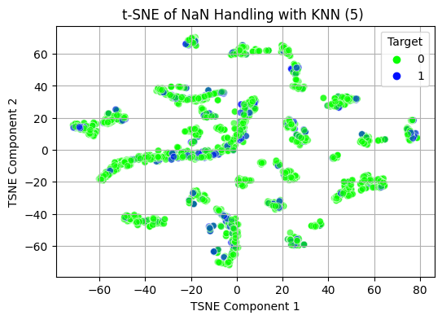
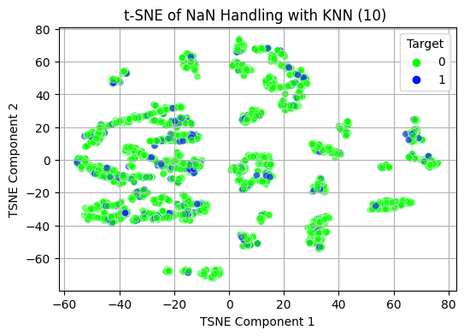
Improvements to Boost Model Performance
Handling Missing Values (MV) through Imputation
Methods:
Mean Imputation (baseline model)
LightGBM’s Native Handling
KNN Based Imputation (5 and 10 neighbours)
Mean Imputation and Binary Flag for MV
Median Imputation and Binary Flag for MV
Exploring Patterns Post-Imputation visually with t-SNE
KNN Based Imputation (5 and 10 neighbours)
CCNY DSE I2100 - Applied ML and Engineering - Credit Risk Project
Notes:
LAU
Here we see the evaluation metrics of each of this models.
What stands out is that when applying KNN based imputation the F1 metric drops, so we are losing the ability to differentiate between positive and negative class. this suggests we are losing information contained in the missing values themself.
Finally the difference between mean and median imputing. we see that with the mean we get better results than with the median. As the median statistics is more robust to extreme values. It suggests that the extreme values contains information useful for making predictions. After this we even tried to build an outlier detection model and use it as a classifier predictor, but we did not get successful results.

Slide 17
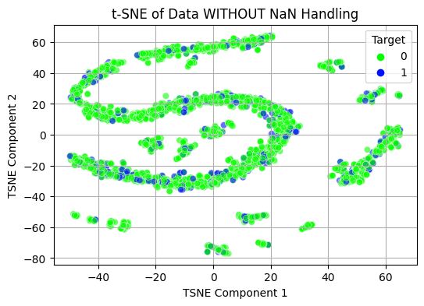
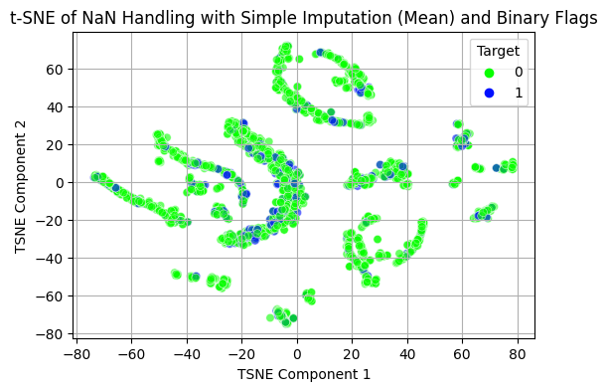
Improvements to Boost Model Performance
Handling Missing Values (MV) through Imputation
Exploring Patterns Post-Imputation visually with t-SNE
CCNY DSE I2100 - Applied ML and Engineering - Credit Risk Project
Notes:
LAU
Let’s start by the first transformation step. We wanted to deal with the missing values in the data. As we do not have enough domain knowledge and the data was not properly explain we cannot even differentiate between the true missing values or incomplete information.
We basically tried out a few methods for imputation, then visualize the results in a scatter plot (using t-SNE which preserve local similarities) checking if the classes were more easily separable and then we build a lightGBM model using that preprocessing step to evaluate the influence in the predictive power.
in this initial plot (top right of the screen) we see the data without any imputation, directly after preprocessing, we see it is very difficult to differentiate between the two classes, they are spread all over and mixed up.
The we tried, KNN imputation with 5 and 10 neighbours, we visually do not see improvements on the separability of the data.
Finally we tried mean and median imputation plus adding a binary flagg to detect with values were missing or not. In this case, we are not only filling up the missing values, we are also telling the model where those values were missing, because this might be relevant. In the button right part of the screen we see that the patterns are slightly more distinct (positive class more concentrated in fewer bloobs). We expect the model to perform better when applying the Mean NaN imputation method and binary missing flags.

Slide 18
Improvements to Boost Model Performance
Handling Missing Values (MV) through Imputation vs Model Baseline
Methods:
Mean Imputation (Same as Model Baseline)
LightGBM Native Handling ≈ Accuracy; ≈ F1
KNN Based Imputation (5 and 10 neighbours) ≈Accuracy; ↓↓(30%) F1
Median Imputation and Binary Flag for MV ≈ Accuracy; ↓(25%) F1
Mean Imputation and Binary Flag for MV ≈Accuracy; ↑(19%) F1
Including the Binary Flag provides more information, capturing total null values by case.
Mean imputation yields better results than median.
Median is more robust to extreme values, which are useful for predictions.
CCNY DSE I2100 - Applied ML and Engineering - Credit Risk Project
Notes:
LAU
Here we see the evaluation metrics of each of this models.
What stands out is that when applying KNN based imputation the F1 metric drops, so we are losing the ability to differentiate between positive and negative class. this suggests we are losing information contained in the missing values themself.
Finally the difference between mean and median imputing. we see that with the mean we get better results than with the median. As the median statistics is more robust to extreme values. It suggests that the extreme values contains information useful for making predictions. After this we even tried to build an outlier detection model and use it as a classifier predictor, but we did not get successful results.

Slide 19
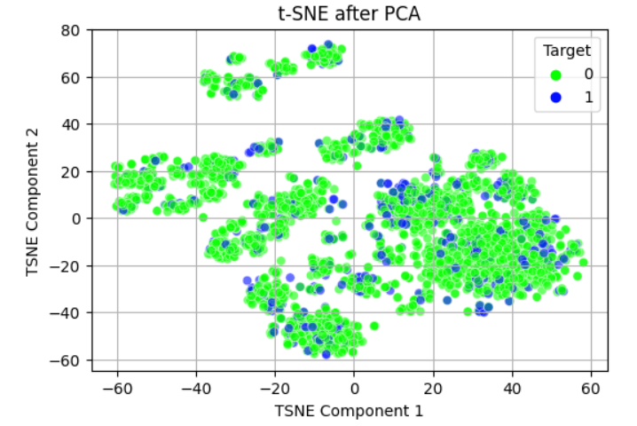
Improvements to Boost Model Performance
Dimensionality Reduction
PCA
Observation:
Several distinct clusters are scattered throughout the space.
No clear separation between the two classes, indicating limited improvement in predictive power.
CCNY DSE I2100 - Applied ML and Engineering - Credit Risk Project

Slide 20
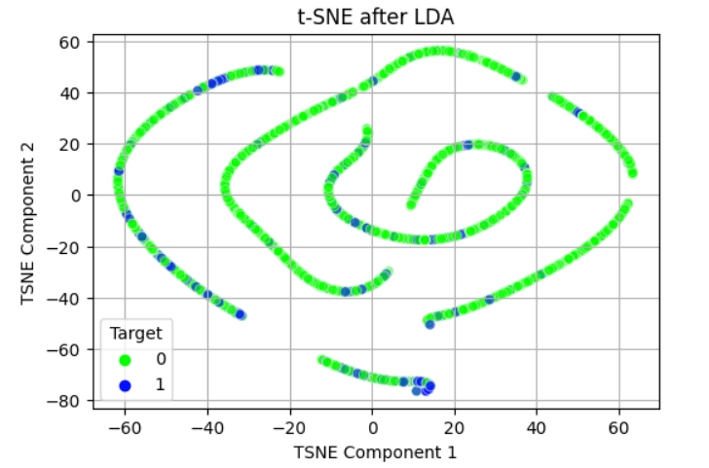
Improvements to Boost Model Performance
Dimensionality Reduction
LDA
Observation:
Classes are more distinctly grouped.
Clearer distinction improves recall and precision.
Comparison to Model Baseline:
≈Accuracy ; ↑(52%) F1
CCNY DSE I2100 - Applied ML and Engineering - Credit Risk Project

Slide 21
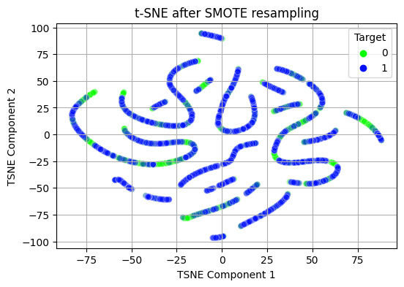
Improvements to Boost Model Performance
Addressing Class Imbalance with SMOTE
SMOTE
Generated synthetic samples for minority class
Comparison to Model Baseline:
↓↓(25%) Accuracy; ↑↑↑(20%) F1
Enhances recall and precision by providing more minority class examples.
CCNY DSE I2100 - Applied ML and Engineering - Credit Risk Project

Slide 22
Final Model
Combining the previous steps
Feature Selection and Extraction
Data Cleaning
Standard Scaler on numerical
LightGBM
Forced regularization
+ L1 and L2
Drop cols with 95% missing values
Pre-process
Data
Aggregations,
join tables, data types
Balance Data
SMOTE
Data
Select features with variance >0.1
Impute mean with binary missing flags
LDA
CCNY DSE I2100 - Applied ML and Engineering - Credit Risk Project
Notes:
LAU
Gathering all the insights we gained and by leveraging the best combinations leading to the best performance metrics, we defined our best model as this: this is just a summary of what we did before, the step implemented in this final model were
Data Preprocessing were we joined the tables, did the aggregations, and transformations of the different data types.
As part of the data cleaning we drop columns with 95% of missing information and we impute the rest of missing information with the mean plus a binary missing flag.
In feature selection and extraction. we standardize the data, select the features with more than 1% of variance and apply LDA dimension reduction.
Last step before the model we apply SMOTE to rebalance the class minority.
And we end by building a LightGBM where we included regularization L1 and L2 penalties as part of the hyperparameter tuning and we hardcoded some of the model parameters grid to reduce the model complexity as well, for example, limiting the number of leaves or the max depth of the trees.

Slide 23
Final Model
Metrics Comparison to Baseline Project Model Performance and Interpretation
Metrics | Project Baseline | Final Model
AUC | 0.78 | 0.64 | This decrease is likely due to the transformations and balancing, which have altered the feature space and class distributions, focusing more on recall improvement.
Accuracy | 0.86 | 0.71 | Has decreased, which is expected in imbalanced datasets when improving recall and precision.
Precision | 0.53 | 0.22 | The significant drop in precision indicates an increase in false positives, which can be attributed to the model's sensitivity to the synthetic minority samples generated by SMOTE, potentially leading to overfitting to the minority class characteristics.
Recall | 0.13 | 0.45 | More effective at identifying actual positive cases. Still makes considerable mistakes.
F1 | 0.21 | 0.30 | Better overall balance between precision and recall, enhancing the model's effectiveness in handling the imbalanced dataset
CCNY DSE I2100 - Applied ML and Engineering - Credit Risk Project
Notes:
LAU
This is the metrics we obtained with the previously explained final model and the comparison to the project baseline.
The AUC has decreased, indicating that the overall discrimination ability between the positive and negative classes has reduced slightly. This decrease is likely due to the transformations and balancing, which have altered the feature space and class distributions, focusing more on recall improvement.
Accuracy has decreased, which is expected in imbalanced datasets when improving recall and precision. The decrease indicates a shift in focus from overall correctness to correctly identifying the minority class.
Precision has improved significantly. The higher precision indicates that the improved model is better at correctly identifying true positives among the predicted positives, reducing false positives.
Recall has increased dramatically, showing that the improved model is more effective at identifying actual positive cases, reducing the false positives. However, in general lines, we would almost miss half of the true positive cases.
The F1 Score, which balances precision and recall, has improved as well. This indicates a better overall balance between precision and recall, enhancing the model's effectiveness in handling the imbalanced dataset. But even if this metric is better than the baseline model, they are still not good enough to be productivized.

Slide 24
Conclusion and Project Lessons
Project Modeling Conclusions
Imputation: Binary flags for missing data added valuable information.
Dimensionality Reduction: LDA improved recall and precision by enhancing class separability.
Re-Sampling: SMOTE balanced the dataset and reduced model bias.
Regularization: Controlled overfitting with model parameters (reg_alpha, reg_lambda).
Accuracy: Still low, not ready for production due to high false negatives.
Project Lessons:
Data Quality: Real-world data is often messy and poorly documented.
Modeling Goal: Achieving marginal gains can be more realistic than aiming for perfection.
CCNY DSE I2100 - Applied ML and Engineering - Credit Risk Project

Slide 25
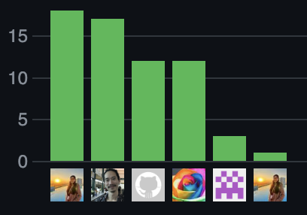
Contributions
Project Diary (link)
SG
WL
LE
AM
LE
SG
CCNY DSE I2100 - Applied ML and Engineering - Credit Risk Project

